Slide 1

Unveil the Principle behind a Solution through Technical Writing
Akihiko K. Sugiyama
Data Science Research Laboratories
NEC Corporation
© 2017 Akihiko K. Sugiyama
No part of this document may be copied without permission.

Slide 2
Tech Writing May not be Easy
You’ll be surprised to see even invited speakers are often bad in presentation.
‘Cause you do not know how. Neither, does your boss! You should know the most efficient way.
Lectures/books help, but feedback is a must. You need consultation.
I have been helping inside and out. 17 invited talks and courses. 80 internship student supervision.
Logical structure is most important and difficult.
A good problem-solution pair is the key to success.
Searching for the right problem-solution pair often unveils the principle behind a solution.
The principle leads to a new/better research.

Slide 3
Contents
Efficient paper writing
Key to the success
Problem-solution pair
Three point analysis
Title of the paper
Topic sentence in Abstract
Example1 : Blue LD
Example 2: Audio coding
Summary

Slide 4
Efficient Paper Writing
Read tech writing books. Practice what are written there.
Prepare slides first. Assume you will perform an oral presentation w/ them.
W/ fonts ≥ 24 pt
Help extract the essence
Will make good logical structure.
Have your draft reviewed by others.
Keep writing for practice.
What is good logic?
Easy to follow (No question/rethinking)
Possible to predict the next content

Slide 5
Slide First !
Page allocation
Use a template (when you’re a novice)
Establish a good problem-solution relation
Paired words often help
Select figures/tables to use
Fill in necessary information in each page
Balance slide allocation and each slide
Reorder slides to modify logic (easy)

Slide 6
Paired Words for Problem-Solution
computations inefficient | efficient compact low complexity low power
slow convergence | fast convergence
degraded | good superior
no analytical support | analysis
no implementation | implementation

Slide 7
Page Allocation
How many pages for what?
Usually, 10 – 15 pages.
Page 1: Background
Page 2: Conventional method
Page 3: Problem of the conventional method
Page 4: Point of the solution and its rationale
Page 5-6: Details of the solution
Page 7-9: Evaluation condition and results
Page 10: Conclusiton/Summary

Slide 8
Order of Preparation
Page 5-6: Details of the solution
Page 4: Point of the solution and its rationale
Page 3: Problem of the conventional method
Page 2: Conventional method
Page 7-9: Evaluation condition and results
Page 1: Background
Page 10: Conclusiton/Summary

Slide 9
Key to the Success
Problem-Solution pair is the key
Clarify the benefit(s) of the research(Paper)
What brings the benefit(s)?
What is the opposite of the benefit(s)
What is the conventional technology w/ the drawback?
Describe it in the 2nd last paragraph of Introduction and design Introduction
Put general applications in the 1st paragraph
Drawback

Slide 10
Introduction
Applications.
How the solution benefit the daily life.
“Who,” (“when”), “what,” and “how it was.”
B. Its feature(s) or contribution
C. Its problem(s)
Most relevant ….
has …. problem.
This paper proposes ..
The next section ……

Slide 11
Three Point Analysis
1. Point of Your Paper
2. Solved Problem
Title of the Paper
Topic Sentence of Abstract
3. Most Relevant Conventional Technology

Slide 12
Point of Your Paper
What is the first in the world?
A.
What is the trick/function to achieve it?
B.
What is a user benefit(s)?
C.
Use the same font size (36 pt), never make box big.

Slide 13
Solved Problem
What is the opposite from the benefit (C)?
Express it w/ C+no or not.
D.
Express D w/o no or not.
E.
E may not exist.
Use the same font size (36 pt), never make box big.

Slide 14
Title of the Paper
Title w/ A and B
F=A+B or B+A, may use up to one conjunction
F
Title w/ all or a part of A, B, and C
if use of C makes the title better than F
G
Use the same font size (36 pt), never make box big.

Slide 15
Topic Sentence of Abstract
Topic sentence using F or G
This paper proposes/presents
followed by the title (F or G)
This paper proposes/presents
Use the same font size (36 pt), never make box big.

Slide 16
Most Relevant Conventional Technology
Conventional technology which has E or D.
1st author
Title starts w/
Reference（conference/journal） w/ month/year
Use the same font size (36 pt), never make box big.

Slide 17
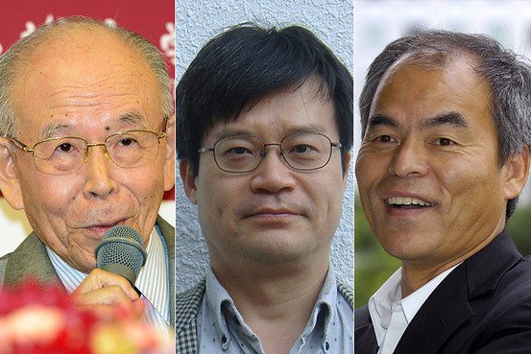
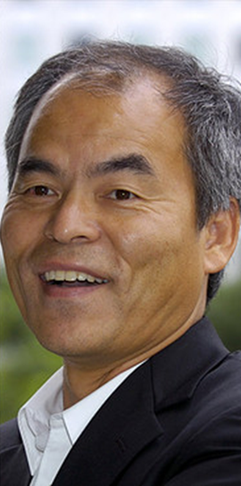
Example 1: Blue LD
Blue LD : 2014 Nobel Prize in Phisics

Slide 18
Problem Analysis and Solution 1
MOCVD
(Metalorganic Chemical Vapor Deposition)
Delivery
Tube
Reactance Gas (NH₃+H₂)
Undelivered
Koide1986
Substrate
Xtal Film

Slide 19
Point of Your Paper
What is the first in the world?
A.
What is the trick/function to achieve it?
B.
What is a user benefit(s)?
C.
MOCVD for blue LD crystal
NH₃ delivery by tube
Blue LD Crystal Deposition
Use the same font size (36 pt), never make box big.

Slide 20
Solved Problem
What is the opposite from the benefit (C)?
Express it w/ C+no or not.
D.
Express D w/o no or not.
E.
E may not exist.
No deposition of blue LD crystal
Blue LD crystal was not deposited
Use the same font size (36 pt), never make box big.

Slide 21
Toyota’s 5 Why’s (Tai’Ichi Ohno, former EDP)
Find the root cause of the problem to fix it.
Problem
1st Why
2nd Why
3rd Why
4th Why
5th Why
1st Cause
2nd Cause
3rd Cause
4th Cause
http://www4.tokai.or.jp/advi-qc/p01.htm
5th Cause
Problem: Crystal is not deposited
Cause 1: Reactance gas is not delivered
Solution: Gas delivery by delivery tube

Slide 22
Problem Analysis and Solution 2
MOCVD
(Metalorganic Chemical Vapor Deposition)
Reactance Gas
Goes up
Pressing Gas
Substrate
Xtal Film

Slide 23
Point of Your Paper
What is the first in the world?
A.
What is the trick/function to achieve it?
B.
What is a user benefit(s)?
C.
MOCVD for blue LD crystal
NH₃ delivery by pressing gas
Blue LD crystal deposition
Use the same font size (36 pt), never make box big.

Slide 24
Solved Problem
What is the opposite from the benefit (C)?
Express it w/ C+no or not.
D.
Express D w/o no or not.
E.
E may not exist.
No deposition of blue LD crystal
Blue LD crystal was not deposited
Use the same font size (36 pt), never make box big.

Slide 25
Toyota’s 5 Why’s (Tai’Ichi Ohno, former EDP)
Find the root cause of the problem to fix it.
Problem
1st Why
2nd Why
3rd Why
4th Why
5th Why
1st Cause
2nd Cause
3rd Cause
4th Cause
http://www4.tokai.or.jp/advi-qc/p01.htm
5th Cause
Problem: Crystal is not deposited
Cause 1: Reactance gas is not delivered
Casuse 2: Reactance gas goes up
Solution: Gas delivery by pressing gas

Slide 26
From Solution to Title
Three Typical Patterns
Benefit for the User + Most Important Keyword
Important Feature + Most Important Keyword
Most Important Keyword + ’What is done’
Most important keyword has been identified by the three point analysis
“First in the world” + “trick/function” to achieve it

Slide 27
Title of the Paper
Title w/ A and B
F=A+B or B+A, may use up to one conjunction
F
Title w/ all or a part of A, B, and C
if use of C makes the title better than F
G
MOCVD for blue LD crystal
with pressing gas
MOCVD for blue LD crystal deposition
with pressing gas
Use the same font size (36 pt), never make box big.

Slide 28
Topic Sentence of Abstract
Topic sentence using F or G
This paper proposes/presents
followed by the title (F or G)
This paper proposes/presents
MOCVD for blue LD crystal fabrication
with pressing gas
Use the same font size (36 pt), never make box big.

Slide 29
Most Relevant Conventional Technology
Conventional technology which has E or D.
1st author
Title starts w/
Reference（conference/journal） w/ month/year
Y. Koide
Epitaxial growth and
J. Electrochemical Society, Sep. 1986
Use the same font size (36 pt), never make box big.

Slide 30
Headder (Nakamura1991)
Novel metalorganic chemical vapor deposition system for GaN growth
Appllied Physical Letter, 58, pp. 2021-2023, May 1991

Slide 31
Abstract (Nakamura1991)
A novel metalorganic chemical vapor deposition (MOCVD) system, which has two different flows, has been developed. One flow carries reactant gas parallel to the substrate, and the other an inactive gas perpendicular to the substrate for the purpose of changing the direction of the reactant gas flow. The growth of a GaN film was attempted using this system, and a high quality, uniform film was obtained over a 2 in. sapphire substrate. The carrier concentration and Hall mobility are 1 ×10¹⁸/cm³ and 200 cm²/Vs, respectively, which are the highest for GaN films grown directly on a sapphire substrate by the MOCVD method.

Slide 32
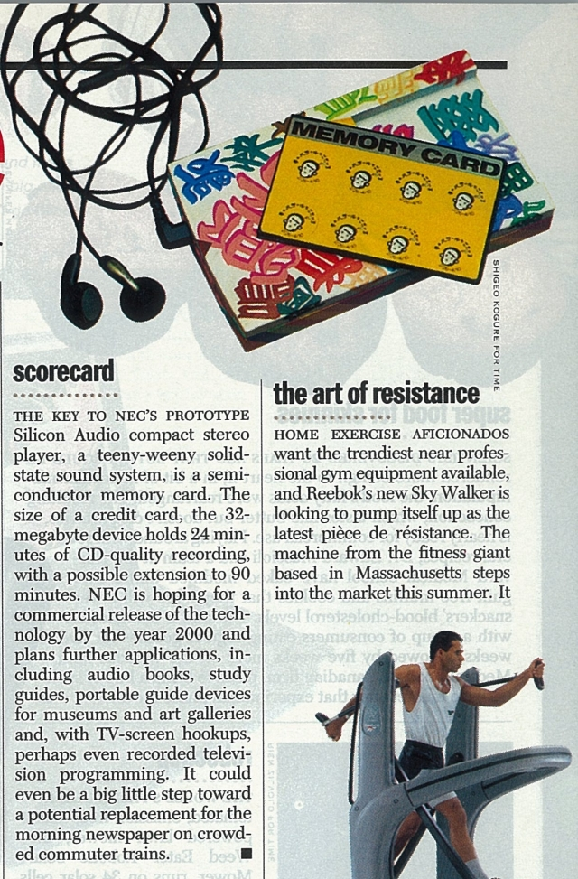
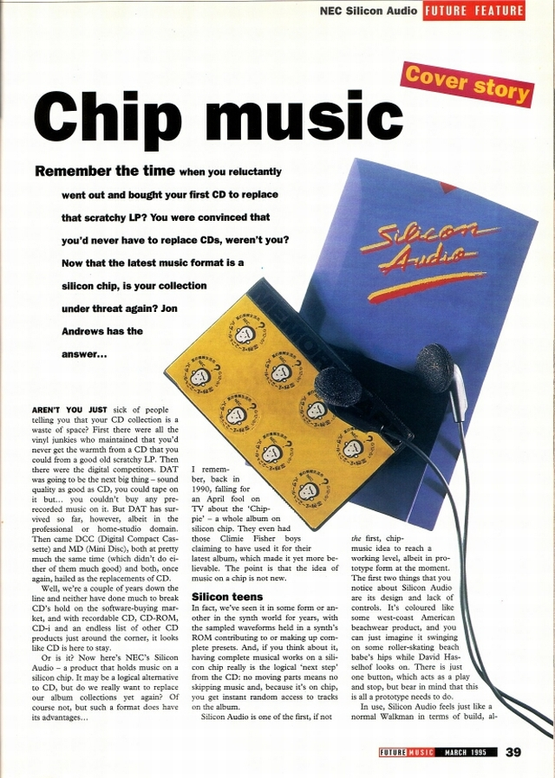
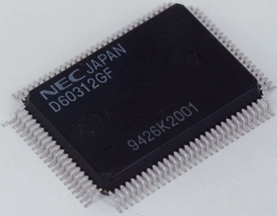
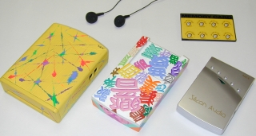
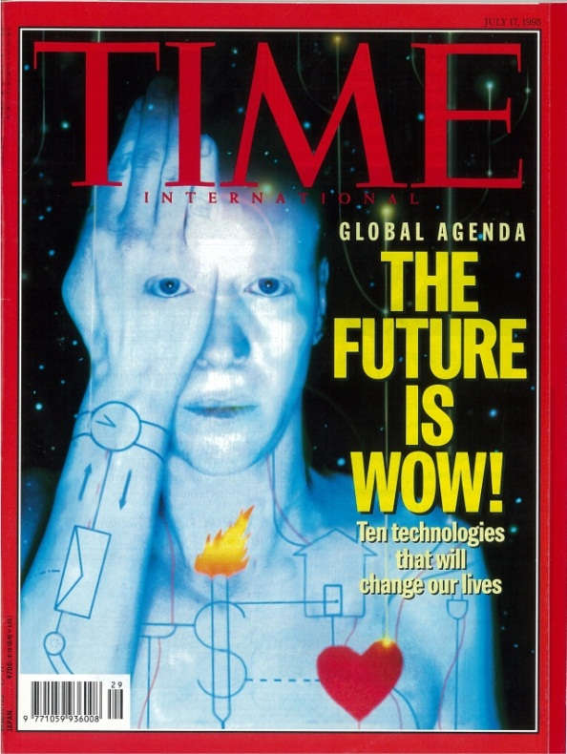
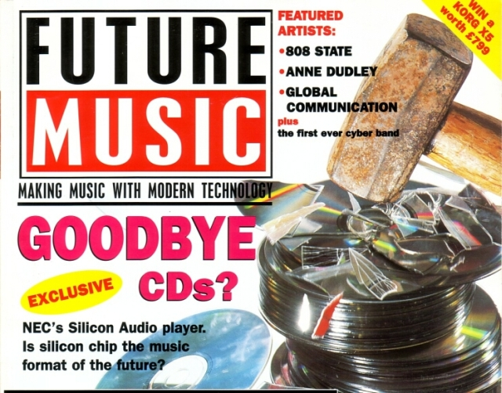
Example 2: MPEG Audio Coding
Good Bye, CDs!
1994
1997
32MB, 24min
1995
July 17, 1995

Slide 33
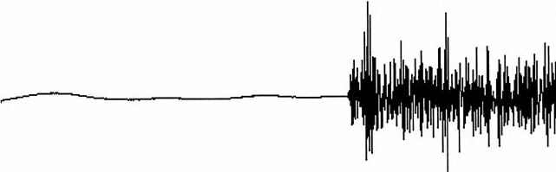
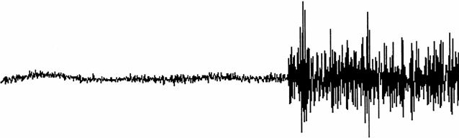
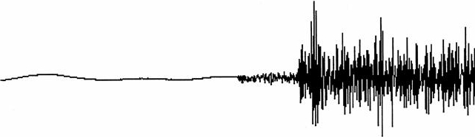
Pre-Echo at Attacks
Pre-echo degrades subjective quality.
Short pre-echo w/ BS 256 （good）and inaudible for
temporary masking
Long pre-echo w/ BS 1024 （bad） and audible
BS 256 needs 4 times as much side info. as
BS1024 (Inefficient)
Source
Block Size: 1024
Audible pre-echo
Pre-echo (preceding noise)
frame
Block Size: 256
256
D
I
D
I
D
I
D
I
Small Distortion
1024
D
D
D
D
I
I
I
I
Inaudible by pre-masking!
D
Effective Data Size

Slide 34
Problem Analysis and Solution 1
Problem: Trade-off between block size and quality
Source
Adaptive Block-Size
Stationary：Long Block
Nonstationay：Short Block
Attack
Long Block (1024)
Audible
Pre-Echo（Preceding Noise）
Segmental SNR [dB]
Short Block (256)
Low Distortion
Inaudible by
pre-masking
“Short (eg. 256)” is automatically selected at an attack (sharp rise).

Slide 35
Point of Your Paper
What is the first in the world?
A.
What is the trick/function to achieve it?
B.
What is a user benefit(s)?
C.
Pre-echo suppression
Adaptive block size transform
High quality audio
Use the same font size (36 pt), never make box big.

Slide 36
Solved Problem
What is the opposite from the benefit (C)?
Express it w/ C+no or not.
D.
Express D w/o no or not.
E.
E may not exist.
Low audio quality
Use the same font size (36 pt), never make box big.

Slide 37
Toyota’s 5 Why’s (Tai’Ichi Ohno, former EDP)
Find the root cause of the problem to fix it.
Problem
1st Why
2nd Why
3rd Why
4th Why
5th Why
1st Cause
2nd Cause
3rd Cause
4th Cause
http://www4.tokai.or.jp/advi-qc/p01.htm
5th Cause
Problem: Pre-echo at attacks
Cause 1: Trade-off between BS and quality
Solution: Adaptive block size transform

Slide 38
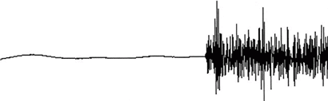
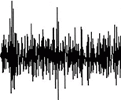
Problem Analysis and Solution 2
Problem: Change in the magnitude in a block
Gain multiplication
Source
Apply staircase gain
to flatten an atack
Attack
Long Block (1024)
Gain
Audible
Pre-Echo（Preceding Noise）
Segmental SNR [dB]
Short Block (256)
Low Distortion
Inaudible by
pre-masking
No attack

Slide 39
Point of Your Paper
What is the first in the world?
A.
What is the trick/function to achieve it?
B.
What is a user benefit(s)?
C.
Pre-echo suppression
Staircase gain
High quality audio
Use the same font size (36 pt), never make box big.

Slide 40
Solved Problem
What is the opposite from the benefit (C)?
Express it w/ C+no or not.
D.
Express D w/o no or not.
E.
E may not exist.
Low audio quality
Use the same font size (36 pt), never make box big.

Slide 41
Toyota’s 5 Why’s (Tai’Ichi Ohno, former EDP)
Find the root cause of the problem to fix it.
Problem
1st Why
2nd Why
3rd Why
4th Why
5th Why
1st Cause
2nd Cause
3rd Cause
4th Cause
http://www4.tokai.or.jp/advi-qc/p01.htm
5th Cause
Problem: Pre-echo at attacks
Cause 1: Magnitude change in a block
Solution: Staircase gain to flatten an attack

Slide 42
Summary
Efficient paper writing
Key to the success
Problem-solution pair: Refinement
Three point analysis
Title of the paper
Topic sentence in Abstract
True problem leads to the principle
Example1 : Blue LD
Example 2: Audio coding

Slide 43


